Slide 1

Junit Framework
By Sumedkumar ​

Slide 2
AGENDA
Introduction​ About Junit
Junit Architecture
​How Junit works
Environment Set up
Junit Methods with Example
Junit Annotation
​Summary​

Slide 3
Introduction
Junit is a framework for run test cases. OR Junit is framework for unit testing.
Unit testing:- It is Test Driven Development (TDD).It is a process where you write the test code first and then you write development code and pass to test.
In order to run test cases, there is platform to run the test cases called Junit Engine.
There are 3 set of API available with Junit 5 to utilise junit platform.
Vintage
Jupiter
3rd Party API

Slide 4
Junit Architecture
Old Tests
Junit 5 Tests
Custom Tests
Vintage
Jupiter
3rd Party
Platform (Junit Engine)
Eclipse, NetBeans, Intelij, Maven, Gradle etc.

Slide 5
How junit works ?
Example:
package edubridge.com;
public class RectangleUtilities {
public static int getArea(int height, int width){
return height* width;
}
public static int getPerimeter(int height, int width){
return 2*(height+width);
}
}
How do you show to the development team that the above methods is working correctly?
Answer, you write junit test and check the test passes.

Slide 6
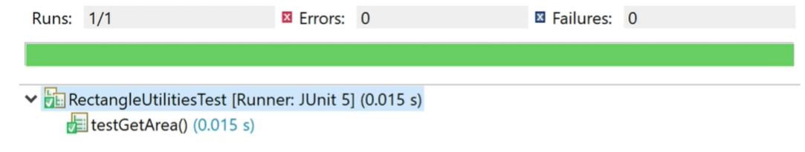
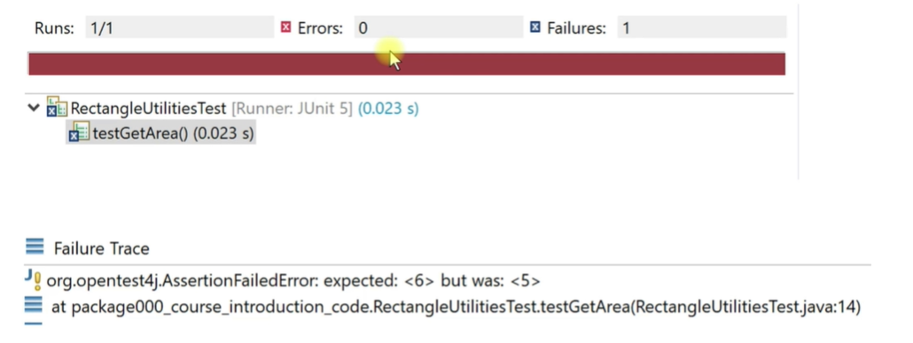
How junit works ? (Cont..)
we write test cases code(see bellow)
package edubridge.com;
import static org.junit.jupiter.api.Assertions.*;
import org.junit.jupiter.api.Test;
class RectangleUtilitesTest {
@Test
public void testGetArea(){
int expected=6;
int actual = RectangleUtilities.getArea(2,3);
assertEquals(expected, actual);
}
}
when you run the test class, if you get green bar(shown bellow)this mean all your test has passed.
What if your test found an error?
Junit show red bar(given bellow) along with a helpful error message

Slide 7
Local environment set up 1)Eclipse/ Netbean/Intelij And JDK 1.5 & Above. OR 2)Eclipse With Maven Project(here We Need To Add Dependency Code In POM.Xml) OR 3)Spring Boot Here We Will Follow First Approach 1) Eclipse And JDK 1.5 Or Above Version

Slide 8
Junit methods
assertEquals
assertNotEquals
assertTrue
assertFalse
assertArrayEquals
Check that 2 primitive/object is equal
Check that an object is not equal
Checks that a condition is true.
Checks that a condition is false.
Check that two Arrays object are equals

Slide 9
Junit methods(Cont..)
Example: assertTrue():
package edubridge.com;
import static org.junit.Assert.assertTrue;
import org.junit.jupiter.api.Test;
class AssertTrueTheory {
@Test
public void test1(){
assertTrue(true);
}
@Test
public void test2(){
assertTrue(4==4);
}
@Test
public void test3(){
assertTrue("edubridge".length()==3);
}
}
Example on assertFalse()
package edubridge.co;
import static org.junit.jupiter.api.Assertions.*
import org.junit.jupiter.api.Test;
class AssertFalseTheory {
@Test
public void myTest(){
assertFalse(false);
assertFalse(2==3);
assertFalse("edubridge".length()==3);
}
}

Slide 10
Annotation in JUNIt
@Test
@BeforeAll
@AfterAll
@After
@Ignore
@BeforeClass & @AfterClass
It tell the junit that the method which is attached run as a test case
Method marked with beforeAll run exactly once prior to the running of test methods.
Method marked with aferAll run exactly once after the running of test methods.
This will perform the method after all tests have finished.
The Ignore annotation is used to ignore the test and that test will not be executed.
@BeforeAll-it run once before any of the test methods in the class.
@AfterClass:-
it run once after any of the test methods in the class.

Slide 11
The development process summery
Write test that strategically test your code.
Keep writing/fixing/refining your code until all of your tests pass.
Ensure you did not break existing code

Slide 12
THANK YOU
sumedkumar
sumedh.manwatkar@gmail.com
https://www.edubridgeindia.com

